Slide 1


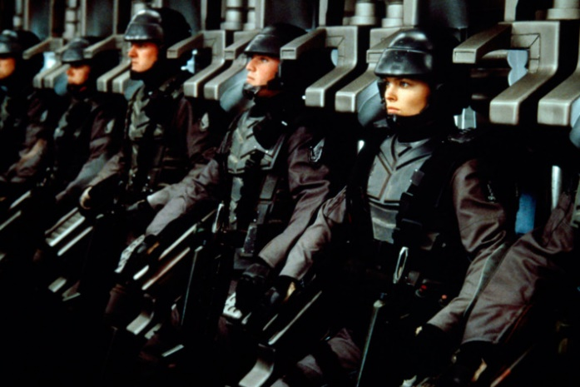
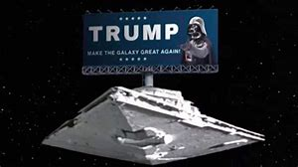

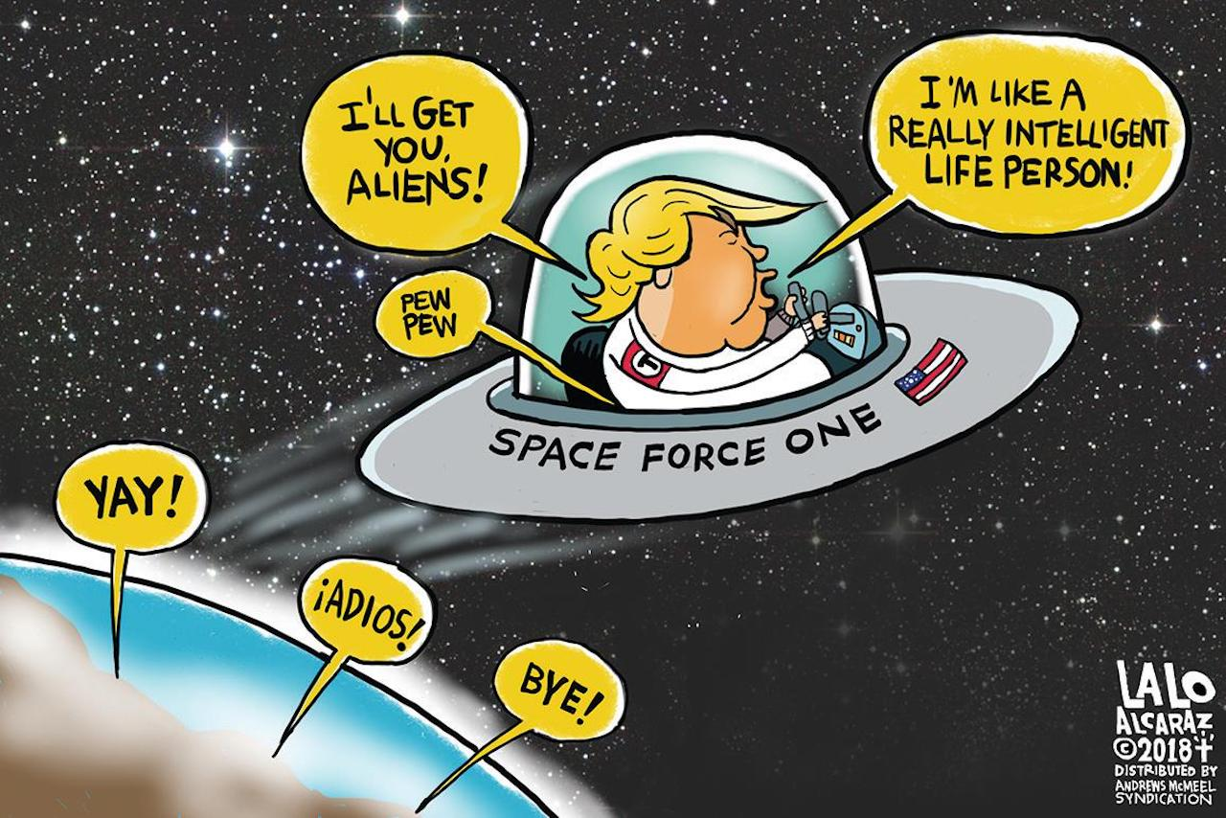
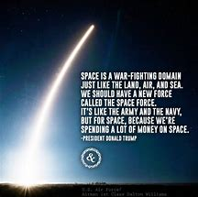
Register
Home
About
News
Enlist
USS Death Star
Sign In
Make The Galaxy Great Again!
JOIN NOW!
Help the thousands already enrolled to ensure American dominance of Space. Whether it’s Russians, Chinese, Romulans, Klingons, Rebel Scum, no one will…

Slide 2
Register
Home
About
News
Enlist
USS Death Star
Sign In
About Us
What is Space Force?
Why do we need Space Force?
Space Force is a new branch of the US Military that is currently in development. The purpose of this new military branch is to establish security and dominance for the United States in Space. We will be monitoring and restricting certain space traffic (namely Chinese).
China shot down a satellite in 2007, littering the orbit with debris. Both China and Russia consider space to be territory that can only be claimed through war. Space Force is necessary to assert American dominance over these weak countries and also to defend from aliens and the like.

Slide 3

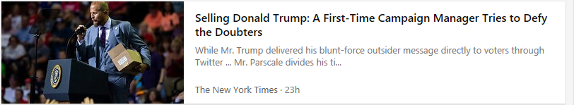

Register
Home
About
News
Enlist
USS Death Star
Sign In

Slide 4

Register
Home
About
News
Enlist
USS Death Star
Sign In
Recruitment Form
Name
Birthdate
Race
Did you vote for trump?
Yes
No
Enlist

Slide 5

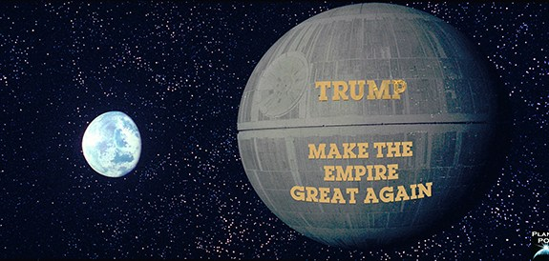

Register
Home
About
News
Enlist
USS Death Star
Sign In
Shhhhh…. Don’t tell the Russians

